Slide 1
STUDENT’S DAILY ACTIVITY MONITORING SYSTEM
Name: Madhurima Ranjit
University Roll No.: 12200119030
Year: 4th Semester: 7th Department: CSE
College Name: St. Thomas’ College Of Engineering And Technology

Slide 2
INTRODUCTION
PROBLEM STATEMENT:
Developing a software application that will cater to day to day activities of our college.
OBJECTIVE:
The aim is to build an application using Android Studio that will cater to the day-to-day activities of our college. The application contains both the user and admin side that makes it more efficient.

Slide 3
LITERATURE REVIEW
In[1] helped to select the essential features of this application.
In[2, 3] helped to learn Android Studio basics.
In[4] helped to build the database.

Slide 4
PROJECT PLANNING
Database
Back-end
Front-end
Designing the interface
Makes the application visually attractive
Storing the required data in tabular format
Implementing the actual working process
Makes the application interactive

Slide 5
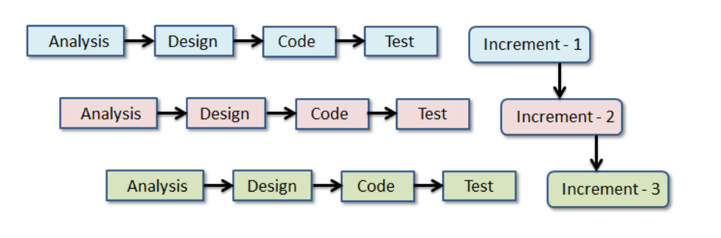
PROJECT DEVELOPMENT MODEL
Incremental Model is used.
The model is designed, implemented and tested as a series of incremental builds until the product is finished.
At each stage of the Incremental Model a new build is coded and then integrated into the structure, which is tested as a whole.

Slide 6
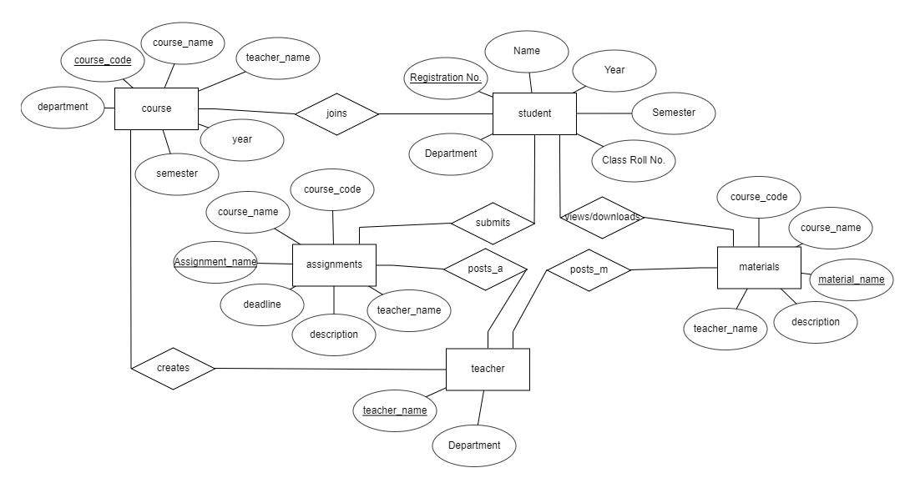
ENTITY-RELATIONSHIP DIAGRAM
M
M
1
1
M
M
M
M
1
1
1

Slide 7
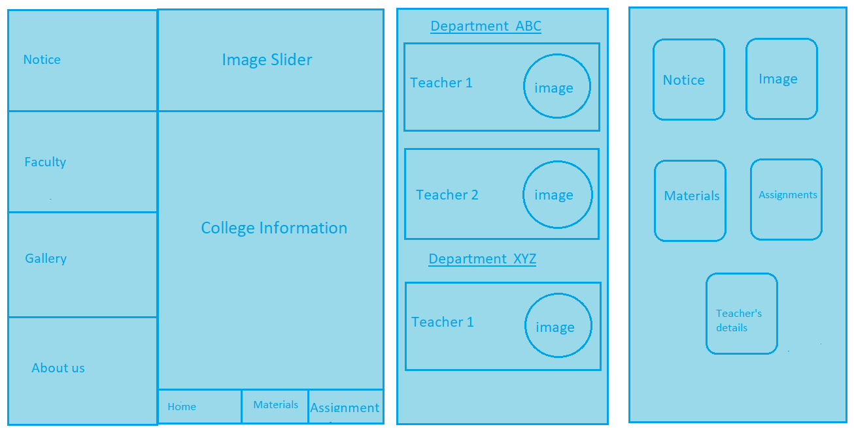
BLUE-PRINTS
User App
Faculty Tab
Admin App

Slide 8
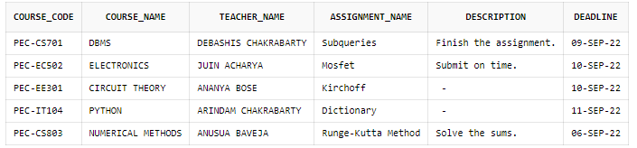
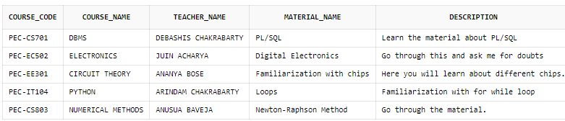
SNAPSHOTS OF THE DATABASE SYSTEM
Assignment Table
Materials Table

Slide 9
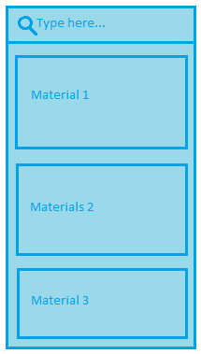
MY PROPOSED METHODOLOGY
Implementing a Search Bar.
It will be implemented using Searchview in Android Studio.
It will fetch the matched values and display them on the current page.
The values will be fetched by ID and ifRoom|collapseActionView.
The method in the backend will be overridden and onCreate() function will the base method.
The query will be passed through setOnQueryTextListener() method.

Slide 10
CONCLUSION
Prototype model is sure to be pre-designed before starting a project.
Pre-implementation research, such as literature review, features selection, learning the tools used in the process of developing the application is essential.
Database needs to be normalized to remove data redundancy and establish data integrity.

Slide 11
REFERENCES
WEB REFERENCE
[1] https://classroom.google.com/
[3] https://developer.android.com/
BOOK REFERENCE
[2] Neil Smith, “Android Studio 4.0 Development Essentials: Java Edition”, Second Edition, Learning Android Studio Hands-on, Page No. 43, Payload Media, 2020
[4] Avi Silberschatz, Henry F. Korth, S. Sudarshan, “Database System Concepts”, Database Design and the E-R Diagram, Page No. 259, Sixth Edition, McGraw-Hill, 2016

Slide 12
THANK YOU

